Slide 1
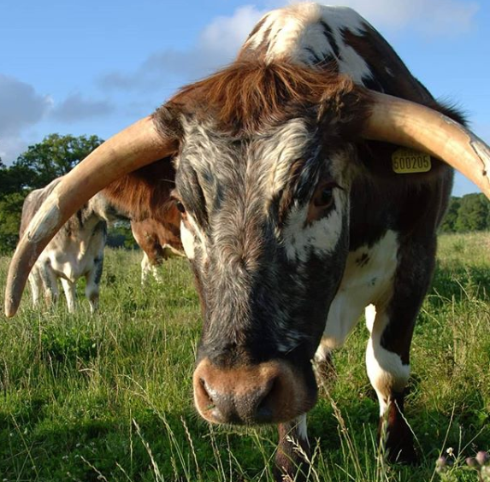
How Does Soil Moisture Effect Large Herbivore Eating Habits in a Rewilding Landscape?
Tia Wassell
Candidate No.: 196175
MRes Animal Behaviour
School of Life Sciences
University of Sussex
2019

Slide 2
Abstract
This is a hidden slide. Write a brief abstract so when people download your slides they can read this and have a bit more of a complete overview of your talk.
This is a hidden slide to don’t worry, this won’t show up when you’re giving your talk
Notes:
You should prepare and deliver using Powerpoint an oral presentation of 15
minutes about your research project.
This should be in the style of a research seminar.
Make sure your Powerpoint slides are clear and well presented. Remember to look at the audience when you
speak to them, and talk clearly and not too fast. Do not read from a prepared script and do not try
and learn is as a recitation ‘by heart’.
It will be followed by several minutes for questions.
Remember that you are the expert on your project, and you should be able to easily answer
questions on it. If you do not understand a question say so. Likely topics are details of methods
and analyses but also broader issues about the background to your project, especially its scientific
context as well as what further work you would have liked to do.

Slide 3
Outline
Background
Introduction
Aims & Hypotheses
Methodology
PrelimINARY Findings
Current Conclusions
Questions

Slide 4
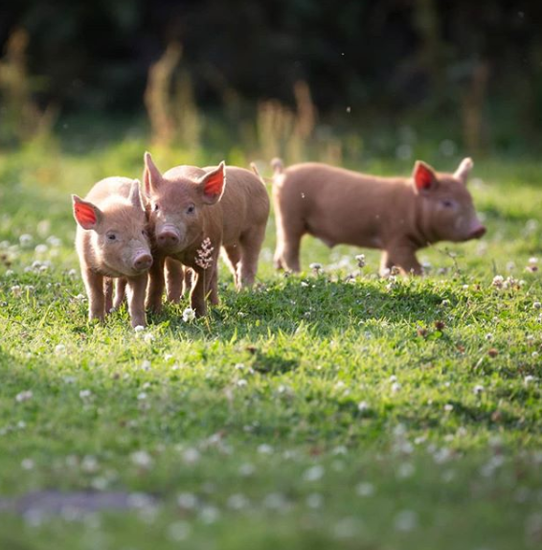
Introduction to Rewilding
What is Rewilding?
A form of conservation coined by Frans Vera (2000) & popularised by George Monbiot (2014).
Definition: “restore (an area of land) to its natural uncultivated state” – Rewilding Britain
How did it originate?
An experiment performed in Amsterdam (“Oostvaardersplassen”) where they allowed nature to take over the previous industrial zone
What are the main features of the field that pertain to your study
Knepp Estate was previously a dairy farm that failed and was turned into a rewilding site. It’s become a pioneering example for other land owners across the country

Slide 5
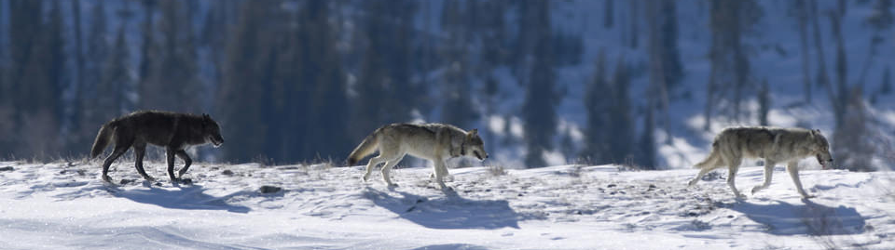
Introduction to Specie Reintroduction
Reintroducing keystone species to encourage a “trophic cascade” to encourage the change of the ecosystem to replicate previous landscapes
Previous experiment examples
Yellowstone National Park reintroduced Wolves (Fritts, et al., 1997)
Other specie reintroduction plans
Reintroduction of wolves to Scotland (Sandom, Bull, Canney & Macdonald, 2011)
Knepp is planning to reintroduce Beavers come September!
Notes:
Discuss some more targeted points that more directly relate to your study (without directly saying “This is because I’m studying this particular thing”)

Slide 6
Ongoing studies Devon Wildlife Trust 1. Willow canopy opened 2. Grass growing healthier 3. Diverse, dynamic habitats have formed 4. Small water sources have become large waterways Scotland Beavers have been approved to stay! Devon First baby wild beavers born in 2015! Welsh & Cornish projects coming soon!
Why Beavers?
Beavers were hunted to extinction in the 16th century.
Reduce downstream flooding
Increase water retention – creating wetland habitats helping wildlife
Clean water – better for fish
Beavers are herbivores!
Reduce siltation, reducing water pollution

Slide 7
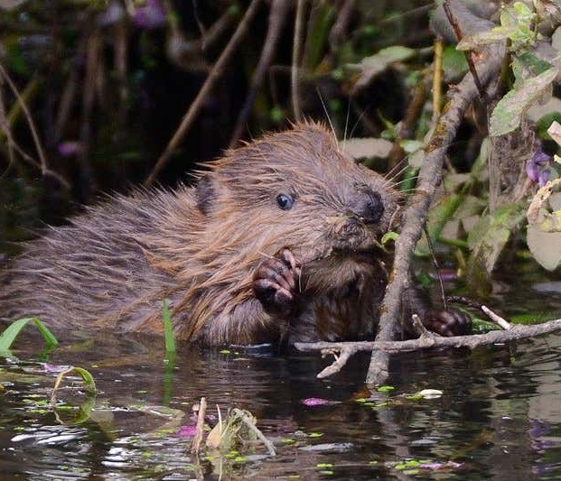
My Study
Aim
See how current large herbivore eating behaviours vary between wetland and dryland in Knepp.
Why?
How will the Beavers effect already present animals and plant diversity in Knepp?
Wolves changed the behaviour of large herbivores in Yellowstone National Park. Will this happen again but by a small herbivore rather than a predator?
How will this be studied? & predictions?

Slide 8
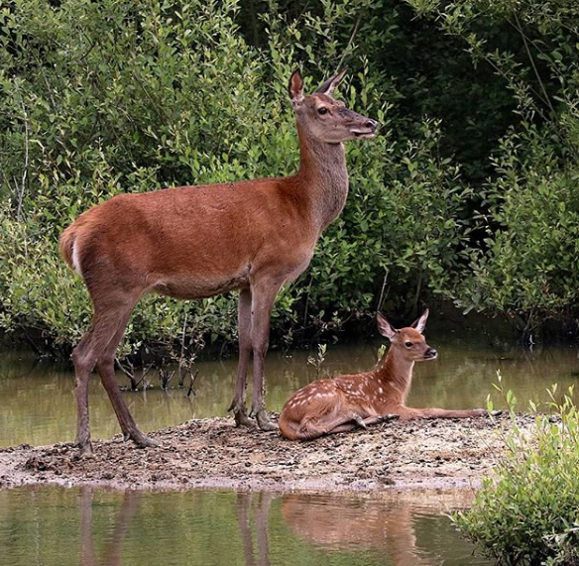
Predictions
1. More grazing behaviours in fields
- Smaller vegetation height average
Predominantly cows & pigs
2. More browsing behaviours in lags
- Deer are likely to exhibit this behaviour more than others
3. Large herbivores tend to go to laggs for drinks and or to wallow only

Slide 9
How?
Who & What?
A comparison of large herbivore behaviours recorded from field and lagg sites with the use of camera traps.
- Longhorn Cows - Red Deer - Tamworth Pigs
- Roe Deer - Fallow Deer
Where & When?
Randomly selected field and lagg sites in the southern block of Knepp for two weeks June – July 2019.
Soil Moisture?
Weather varied a lot during data-collection so plant observations were used to determine wetland sites.
Drone data was also collected to look at vegetation height.
Interpreting Data?
Any trends found should be a good indicator of what could happen with large herbivore eating habits if the soil moisture levels increase or decrease
I.e. graze/browse more in one area than another, effects on plant diversity & insect populations

Slide 10
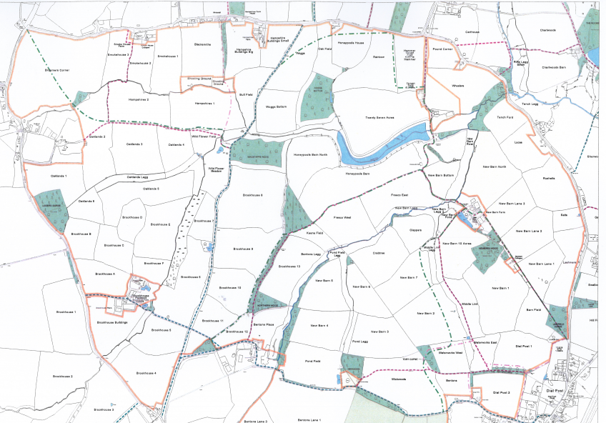
Key
Lagg Camera
Field Camera
Fields were randomly selected by numbering and having a random number generator choose 10 numbers.

Slide 11
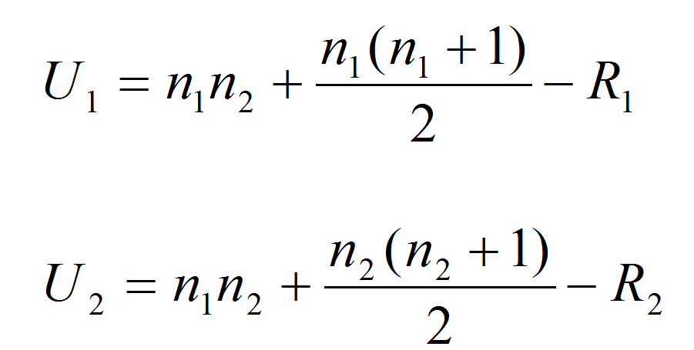
Data Analysis
Behaviours will be analysed using a Mann-Whitney U test.
Data is non-normally distributed due to observation
N sample 1 x N sample 2
Sample 1 = Field
Sample 2 = Lagg
Total Sample 1
Total Sample 2

Slide 12
Discussion of the data collected
Data Analysis
Each individual coded per video into species & behaviour
1. Drinking + times (secs) 4. Observing 7. Distance
2. Grazing + times (secs) 5. Passing Through
3. Browsing + times (secs) 6. Wallowing
General Observations
Larger group congregation in lag area than fields.
More videos for lag condition as camera traps are motion sensored
- Birds loved high activity areas. Videos with small or no animals were discarded.
- Large herbivores tend to pass through the fields so less videos for that condition

Slide 13
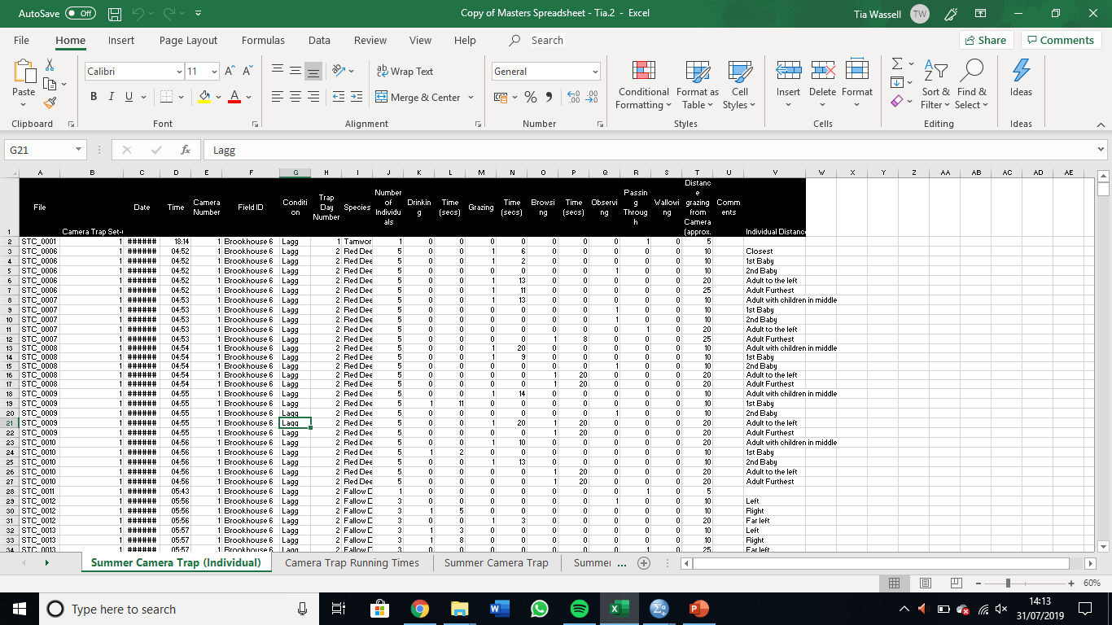

Slide 14
General Observations
Mean No. of Individuals

Slide 15
General Observations
Mean Time Spent Grazing

Slide 16
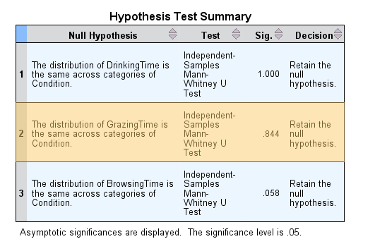

Slide 17
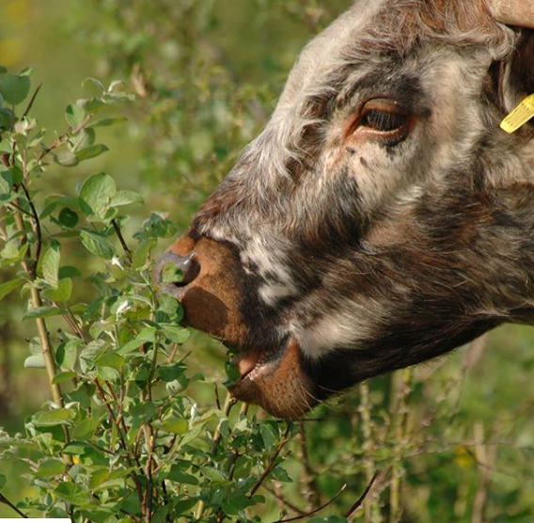
Current Findings
Suggestions of specie-specific behaviour
1. Cows prefer fields?
Higher population of cows at Knepp – Will cows grazing freedom be reduced due to potential waterlogged fields?
2. Deer prefer laggs?
Will the Deer population grow?
3. What will pigs prefer?
Results are based on low statistics so I am excited to see what happens with the addition of more data.

Slide 18
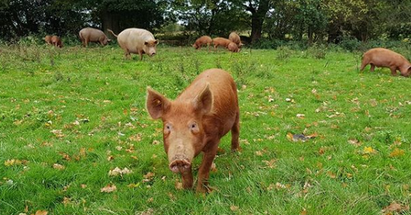
Discussion
Currents findings are suggesting there is a small amount of variance in eating behaviour between species.
Will this remain the same as data is added?
Previous research:
1. Menard, et al. (2002) – variance in feeding behaviour between horses & cattle in marshlands
2. Martin, et al. (2015) – Comparison of Wildebeast grazing behaviours in wet season to dry season
3. Felton, et al. (2016) – Large herbivores balancing their own diet

Slide 19
Future work
Improvements?
- Have direct comparisons of cameras in both field and lagg
- In-depth NVC surverys
- Avoid public paths
Apply to other species?
- Effect on insects population diversity
- Bird nesting locations
- Effect on Bats
- Effect on Amphibians
What are the natural extensions of the study?
- Compare seasonal behaviours & locations
- Perform pre & post beaver introduction
- Variance in other locations in & outside of UK?
- Extended study time

Slide 20
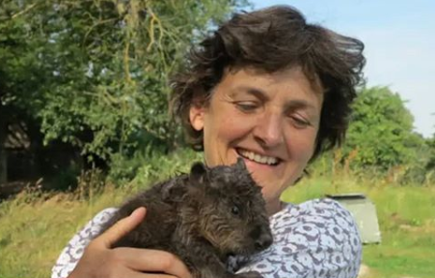
Conclusions
In conclusion, rewilding aims to restore Knepp to its prior landscape before human interference.
In my study, we have explored the eating patterns of large herbivores. We have found there to be preference in feeding sites for different species.
This will potentially allow us to make predictions on the changes the beavers will make to Knepp and anticipate how to best aid the restoration of land if needs be.

Slide 21

Thank you for listening
If anyone has any questions I’d be happy to answer them.

Slide 22

References
Vera, F.W.M., 2000. Grazing ecology and forest history. CABI publishing.
Monbiot, G., 2014. Feral: Rewilding the land. Sea and Human Life, Chicago: University of.
Britain, R. (2019). Rewilding. [online] Rewilding Britain. Available at: https://www.rewildingbritain.org.uk/rewilding/ [Accessed 31 Jul. 2019].
Fritts, S.H., Bangs, E.E., Fontaine, J.A., Johnson, M.R., Phillips, M.K., Koch, E.D. and Gunson, J.R., 1997. Planning and implementing a reintroduction of wolves to Yellowstone National Park and central Idaho. Restoration ecology, 5(1), pp.7-27.
Sandom C., Bull J., Canney S., Macdonald D.W. (2012) Exploring the Value of Wolves (Canis lupus) in Landscape-Scale Fenced Reserves for Ecological Restoration in the Scottish Highlands. In: Somers M., Hayward M. (eds) Fencing for Conservation. Springer, New York, NY
Menard, C., Duncan, P., Fleurance, G., Georges, J. and Lila, M. (2002). Comparative foraging and nutrition of horses and cattle in European wetlands. Journal of Applied Ecology, 39(1), pp.120-133.
Martin, J., Benhamou, S., Yoganand, K. and Owen-Smith, N. (2015). Coping with Spatial Heterogeneity and Temporal Variability in Resources and Risks: Adaptive Movement Behaviour by a Large Grazing Herbivore. PLOS ONE, 10(2), p.e0118461.
Felton, A., Felton, A., Raubenheimer, D., Simpson, S., Krizsan, S., Hedwall, P. and Stolter, C. (2016). The Nutritional Balancing Act of a Large Herbivore: An Experiment with Captive Moose (Alces alces L). PLOS ONE, 11(3), p.e0150870.

